Slide 1

Faculty of Digital Transformation
Educational program: Big Data and Machine Learning
Subject area: 01.04.02 Informatics and Applied Mathematics
Report of Laboratory task 1
“Predicting the number of publications”
Ivanchik Elizaveta, J4234c
Tsaplina Ekaterina, J4233c
Saint-Petersburg
2023

Slide 2
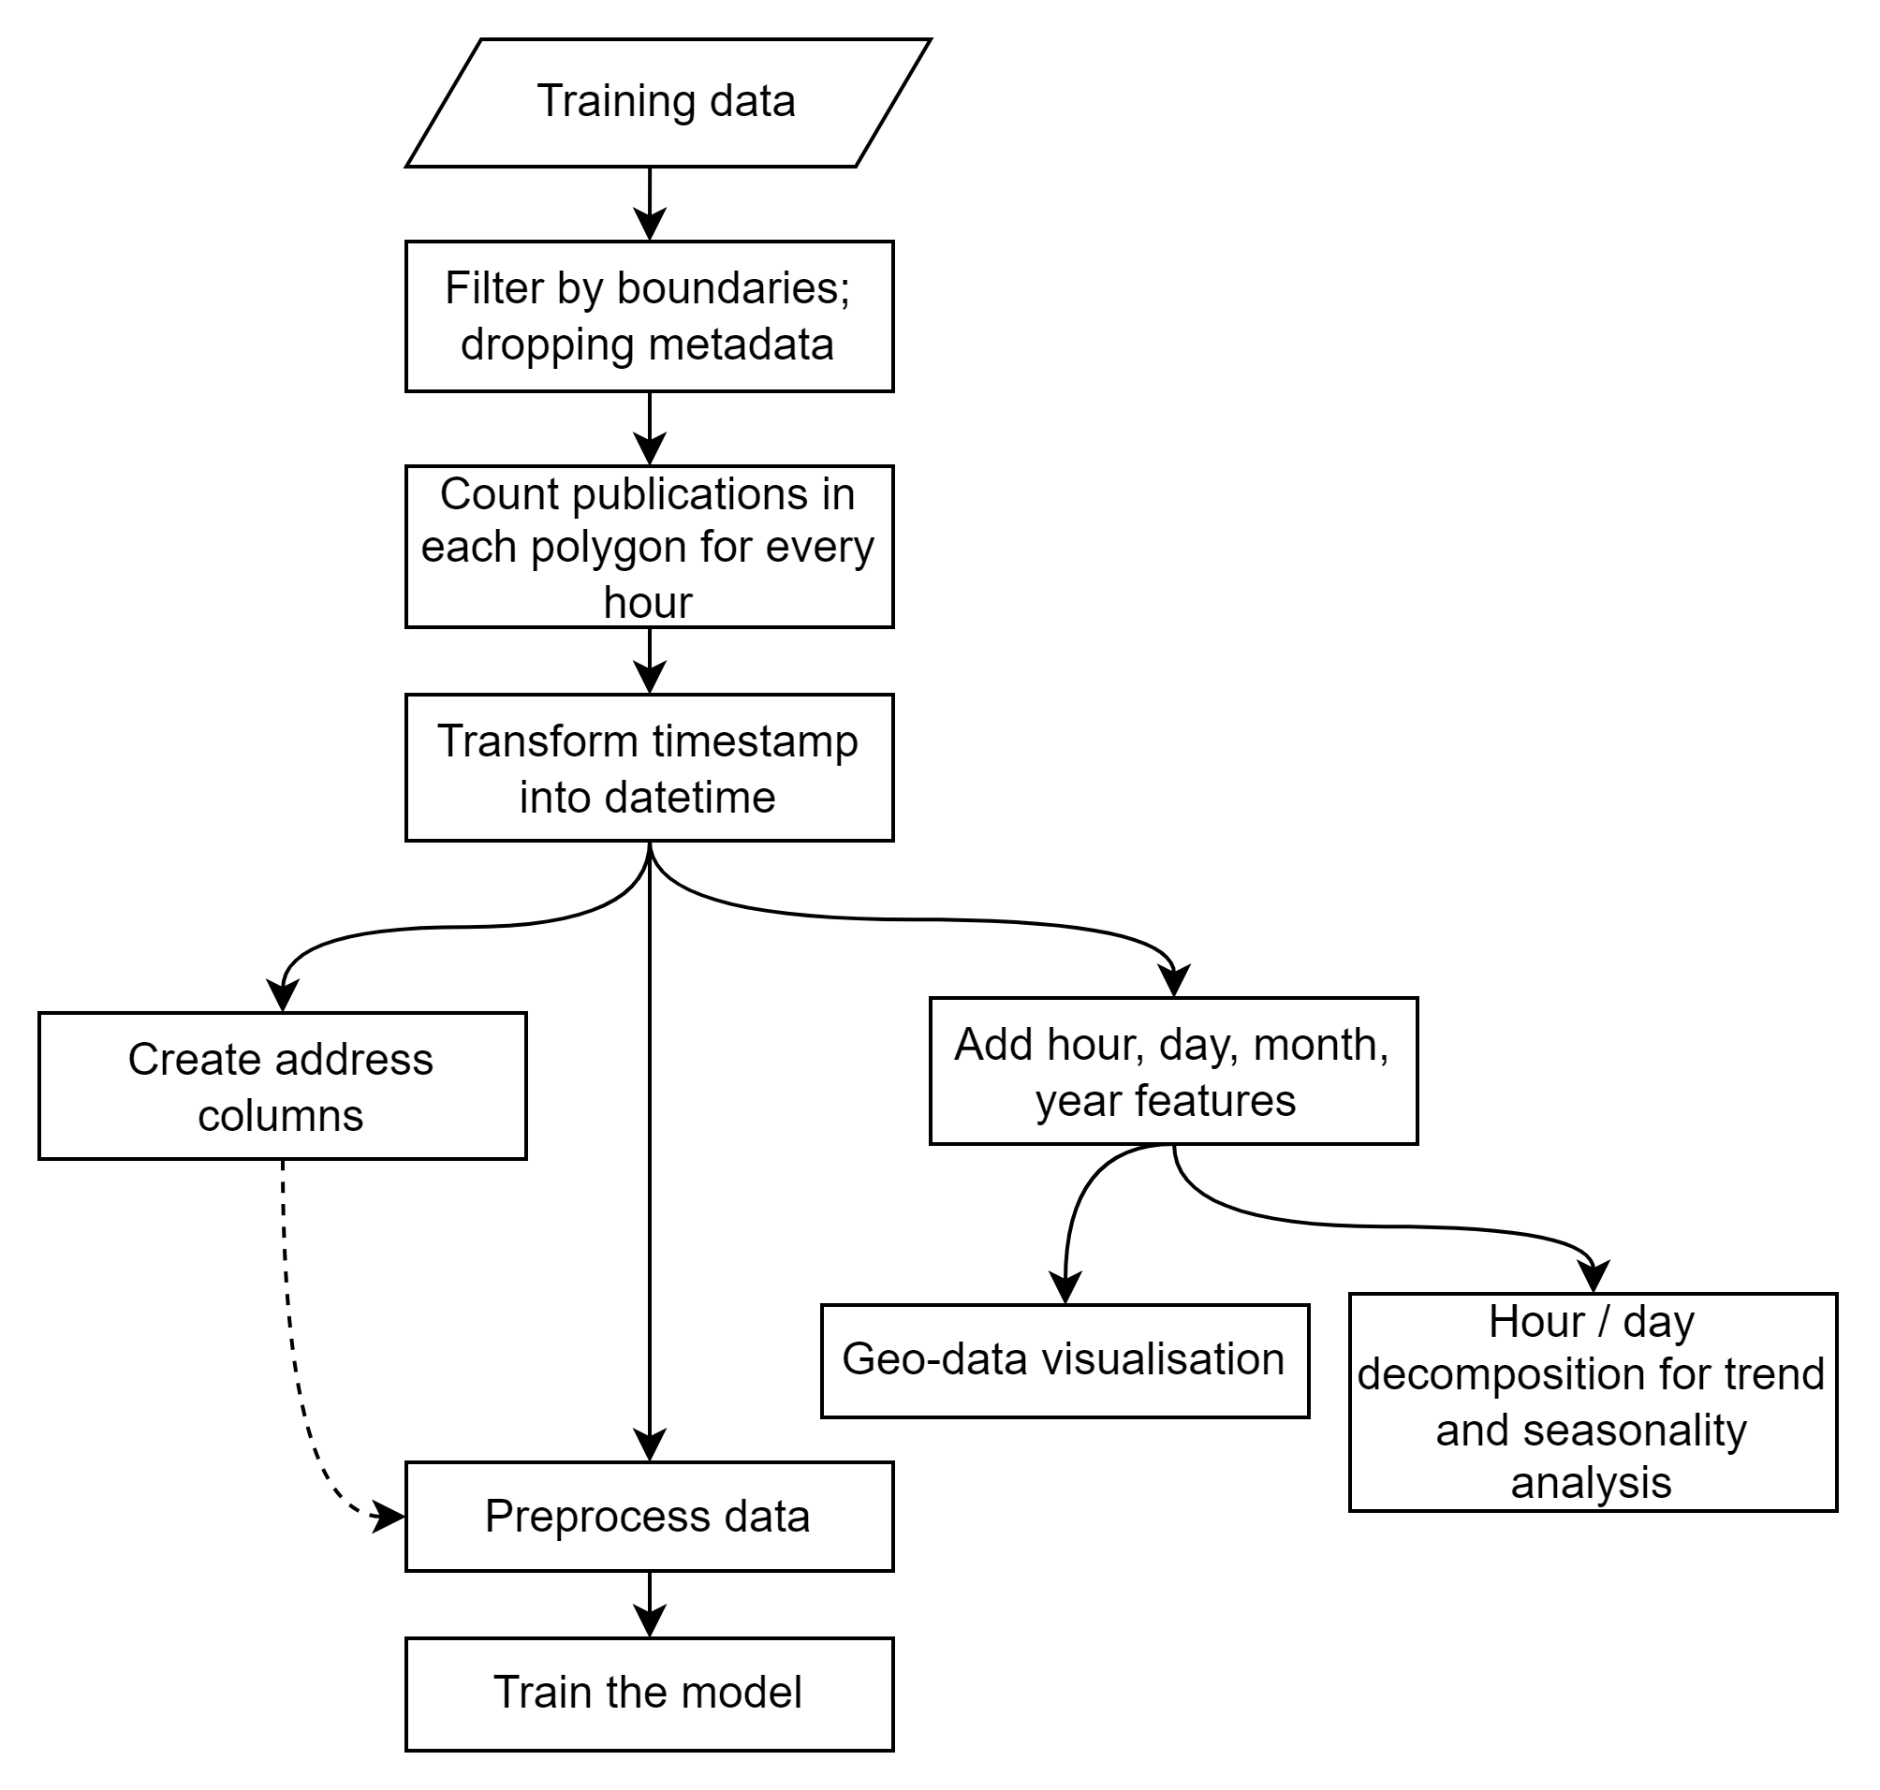
Data transformation overview
Data transformation outline

Slide 3
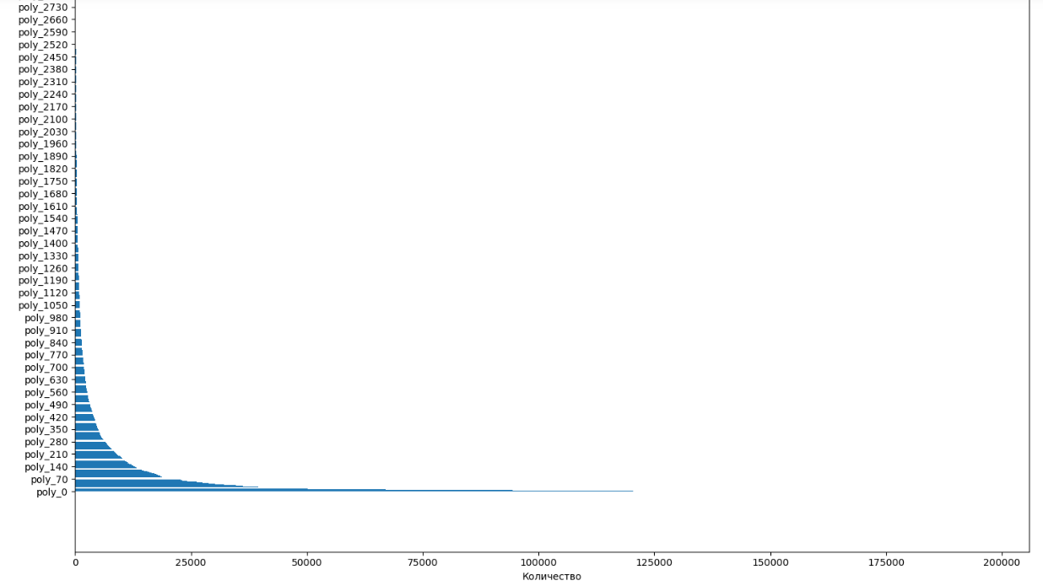
Exploratory data analysis
Number of publication records for each polygon

Slide 4
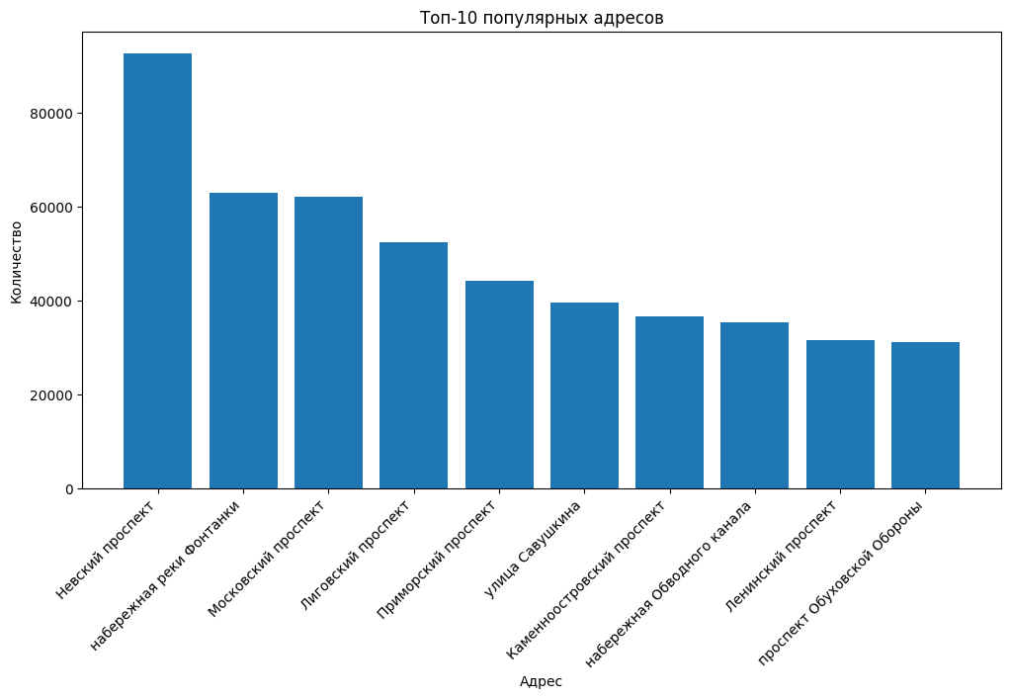
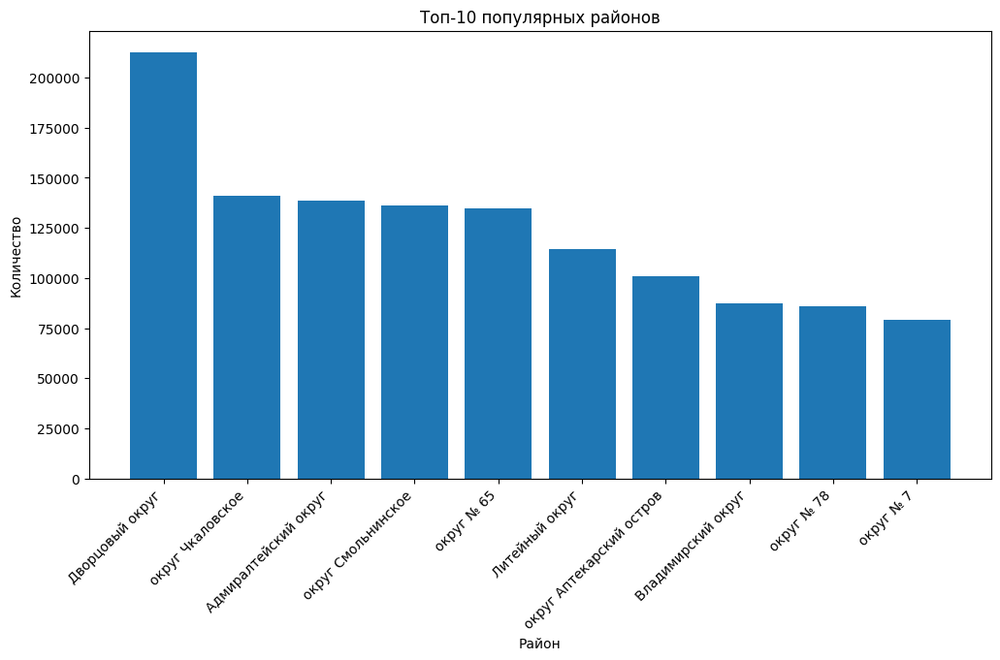
Exploratory data analysis
Top 10 addresses and regions with the highest number of publications

Slide 5
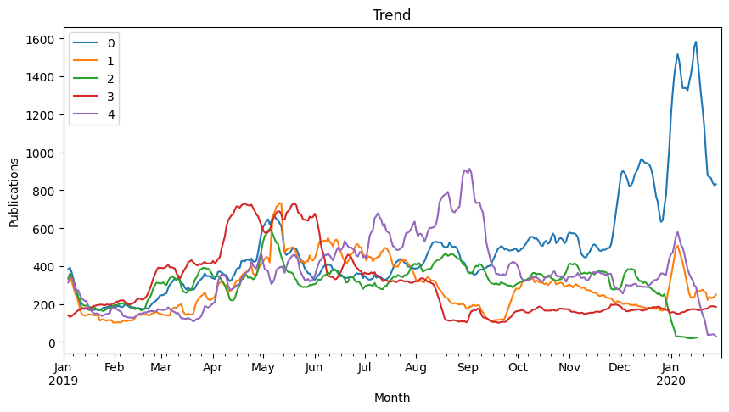
Time series analysis: Trend
Trend plots for 5 polygons with the highest number of publications

Slide 6
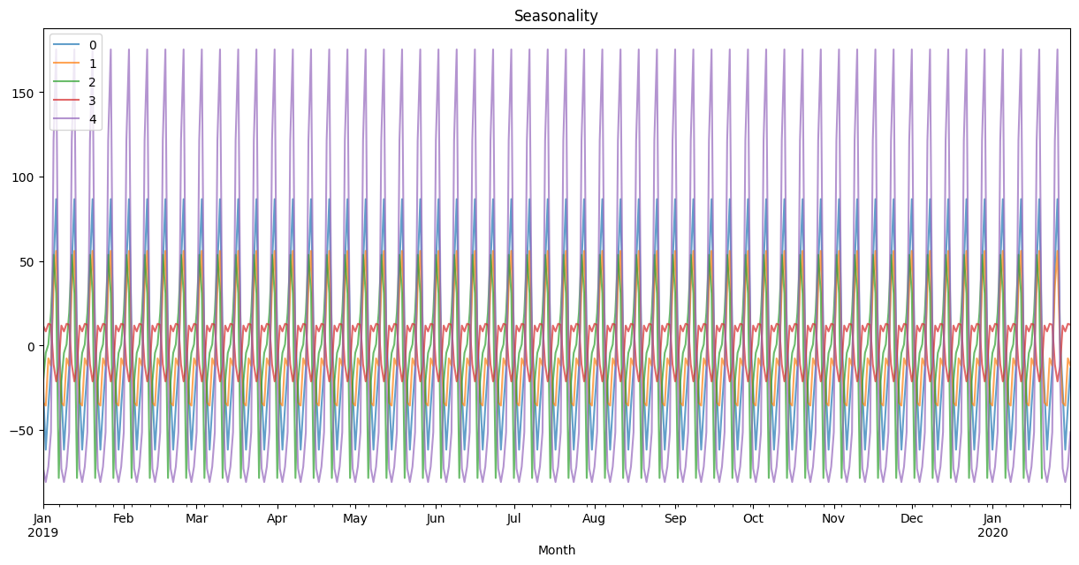
Time series analysis: Seasonality
Seasonality by week during one year (5 polygons with the highest number of publications)

Slide 7
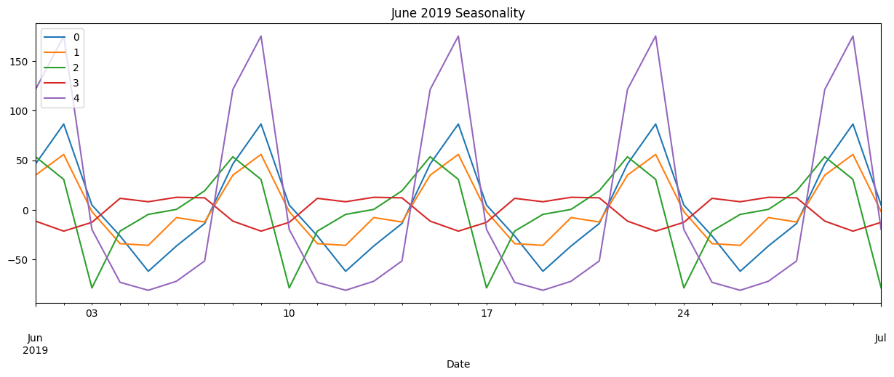
Time series analysis: Seasonality
Seasonality by weekday during June 2019
(5 polygons with the highest number of publications)

Slide 8
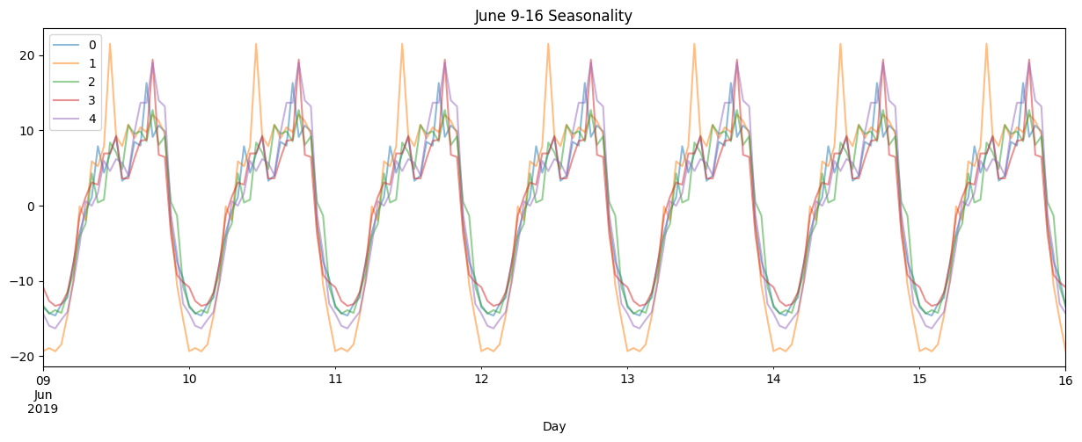
Time series analysis: Seasonality
Seasonality during one week (from June, 9 till June, 16)

Slide 9
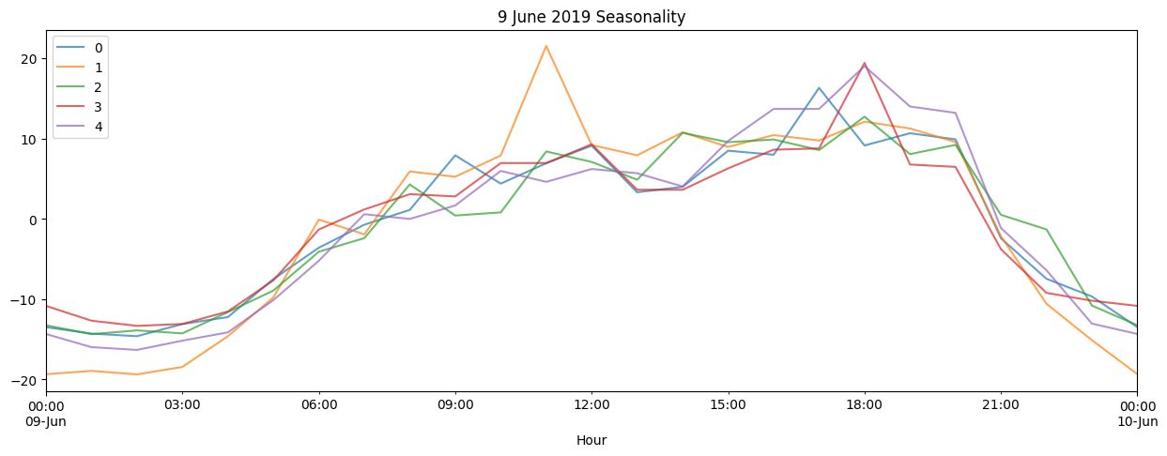
Time series analysis: Seasonality
Seasonality during June, 9

Slide 10
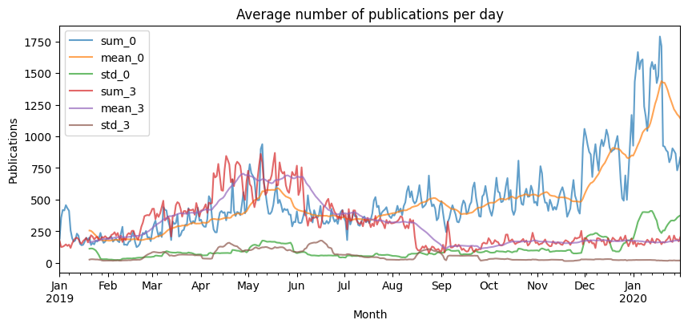
Time series analysis: Rolling average plot
Average number of publications for 5 polygons with the highest number of publications

Slide 11
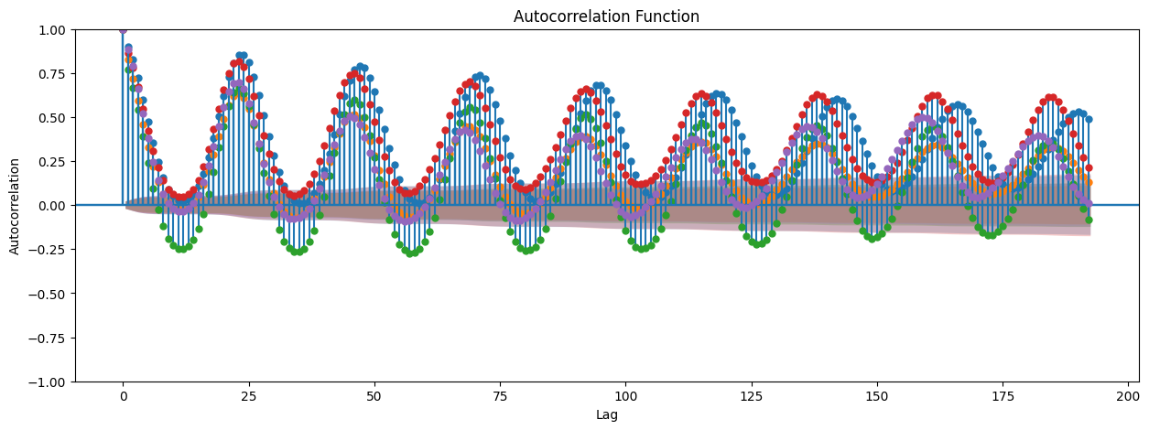
Time series analysis: Autocorrelation
Autocorrelation graph for 5 polygons with the highest number of publications

Slide 12
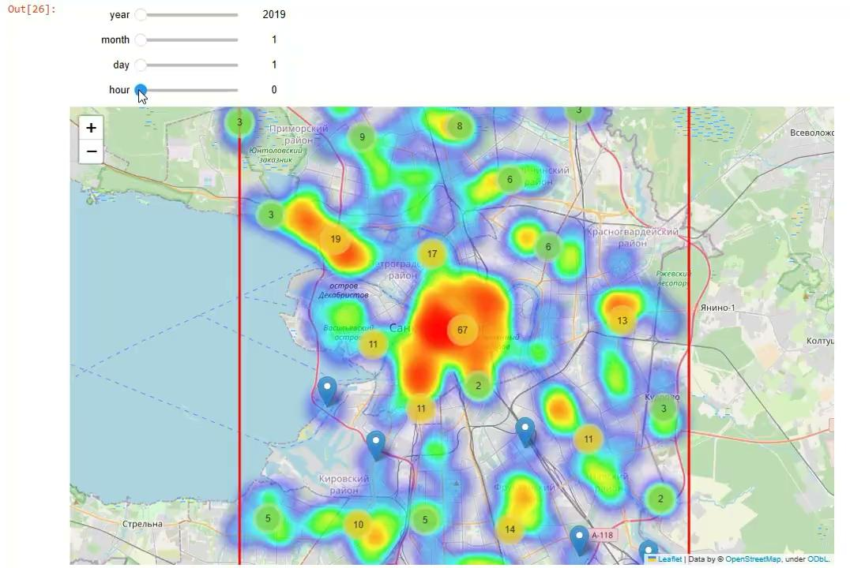
Visualization of geo-data

Slide 13
Model 1: Linear regression

Slide 14
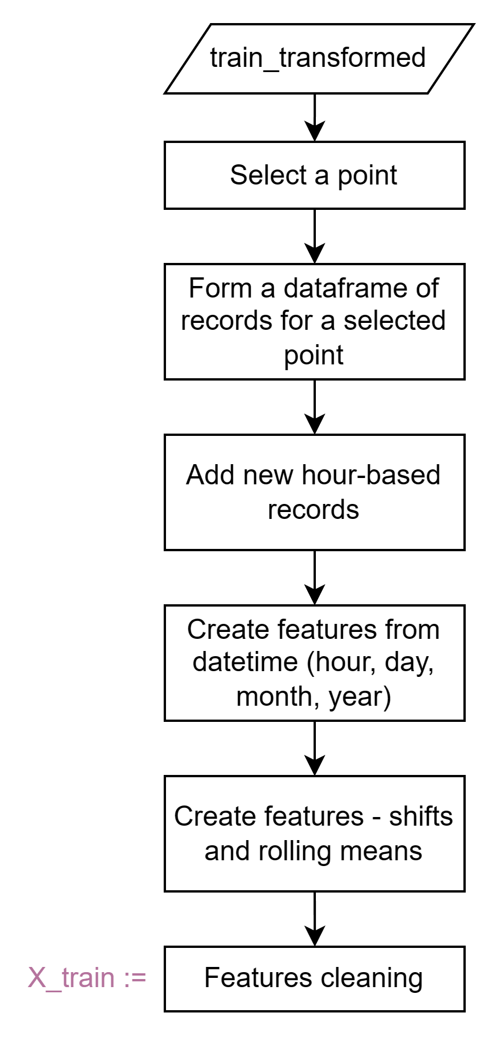
Linear regression: Data preparation
Scheme of data preprocessing algorithm

Slide 15
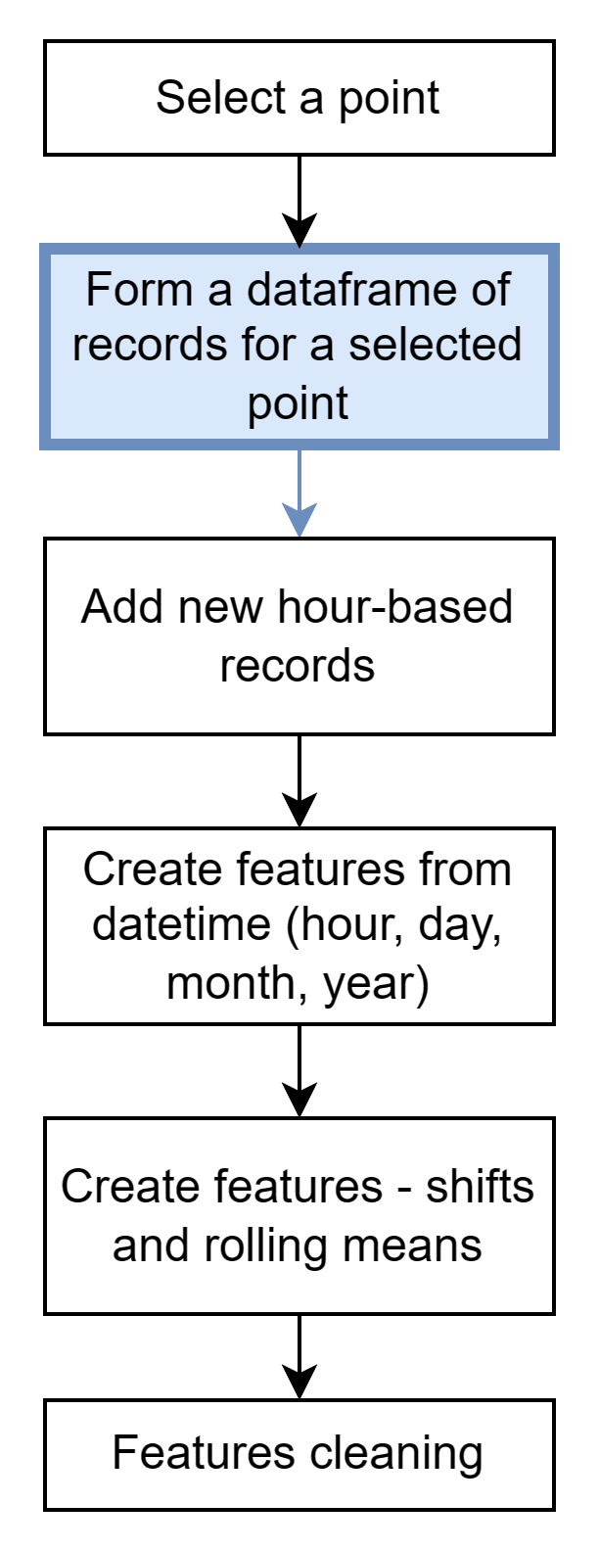
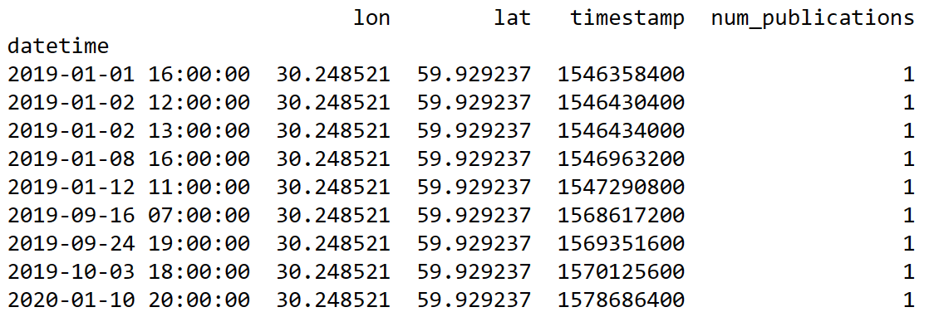
Linear regression: Data preparation
Dataframe example for point 0101000020E610000002BF48199F3F3E400A41C338F1F64D40

Slide 16
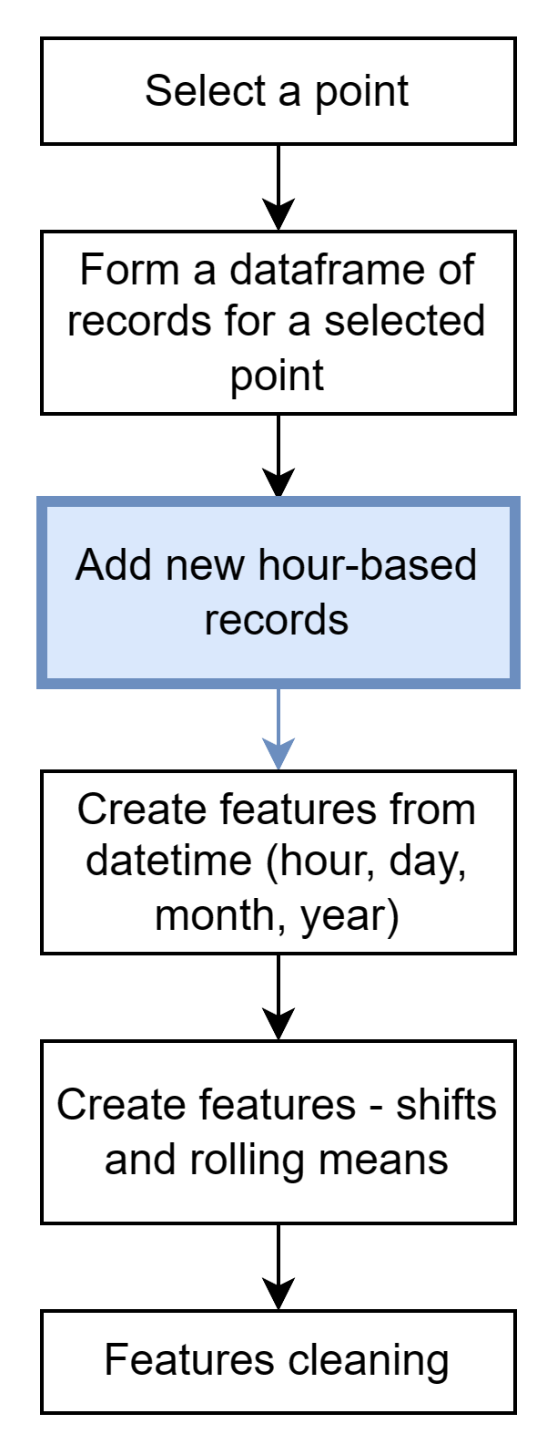
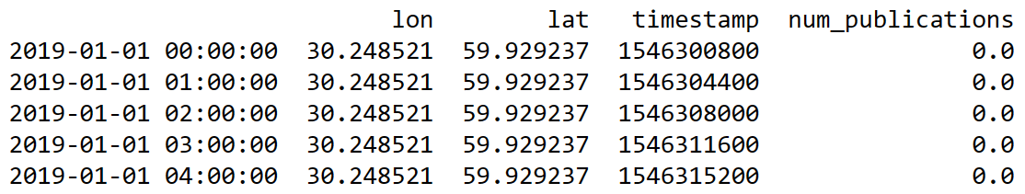
Linear regression: Data preparation
Dataframe example for point 0101000020E610000002BF48199F3F3E400A41C338F1F64D40

Slide 17
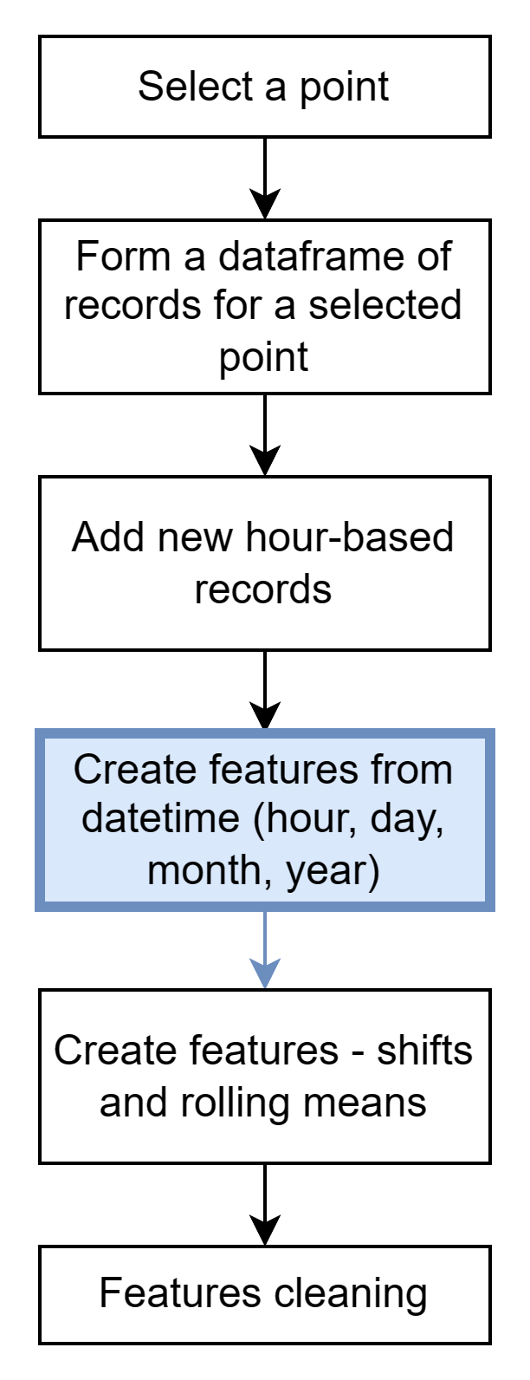
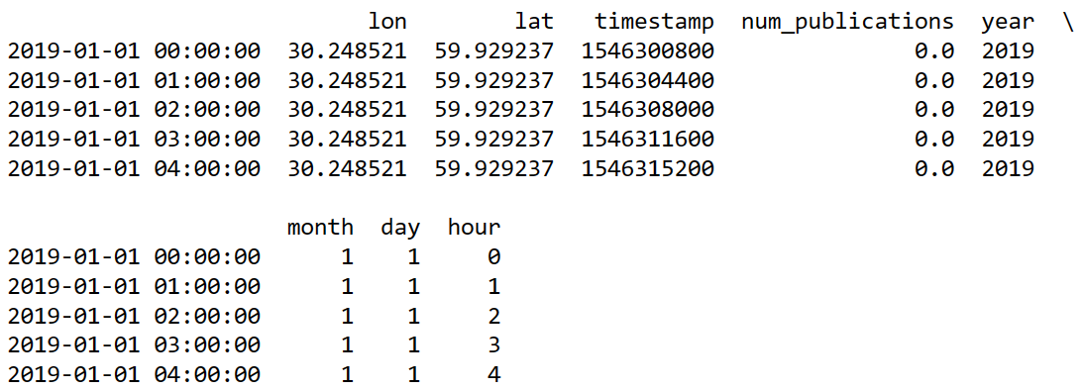
Linear regression: Data preparation
Dataframe example for point 0101000020E610000002BF48199F3F3E400A41C338F1F64D40

Slide 18
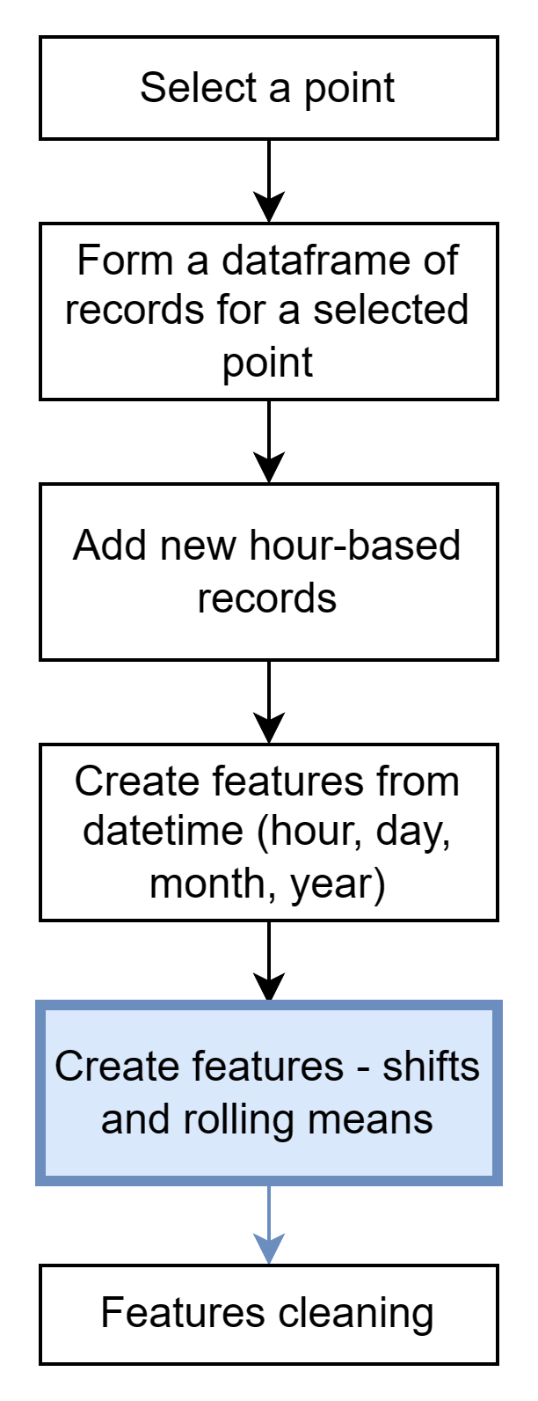
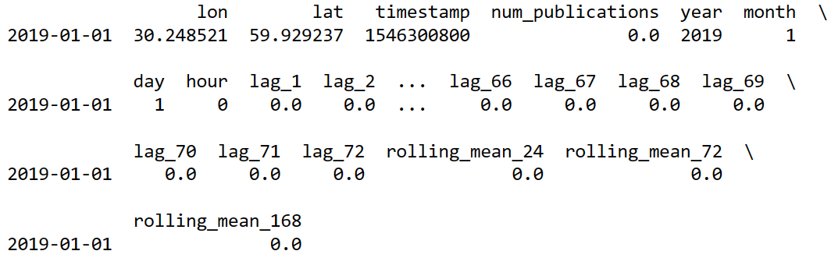
Linear regression: Data preparation
Dataframe example for point 0101000020E610000002BF48199F3F3E400A41C338F1F64D40

Slide 19
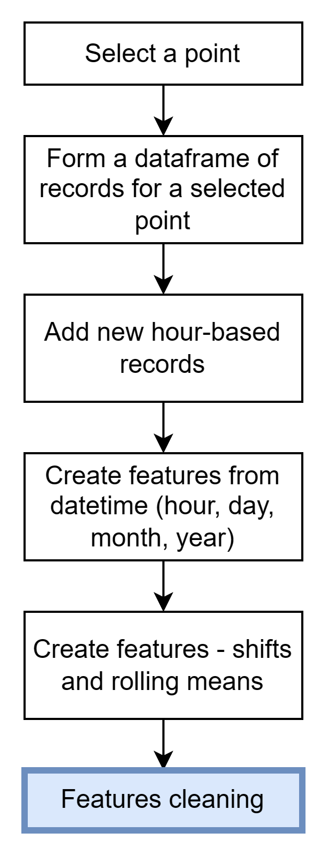
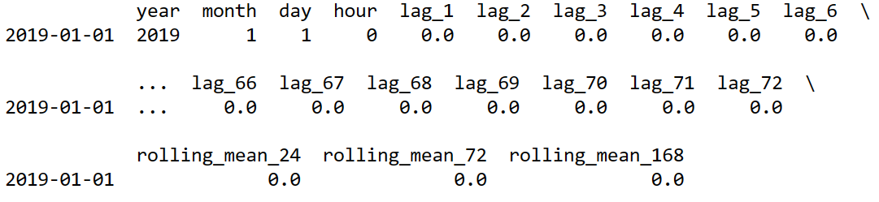
Linear regression: Data preparation
Dataframe example for point 0101000020E610000002BF48199F3F3E400A41C338F1F64D40

Slide 20
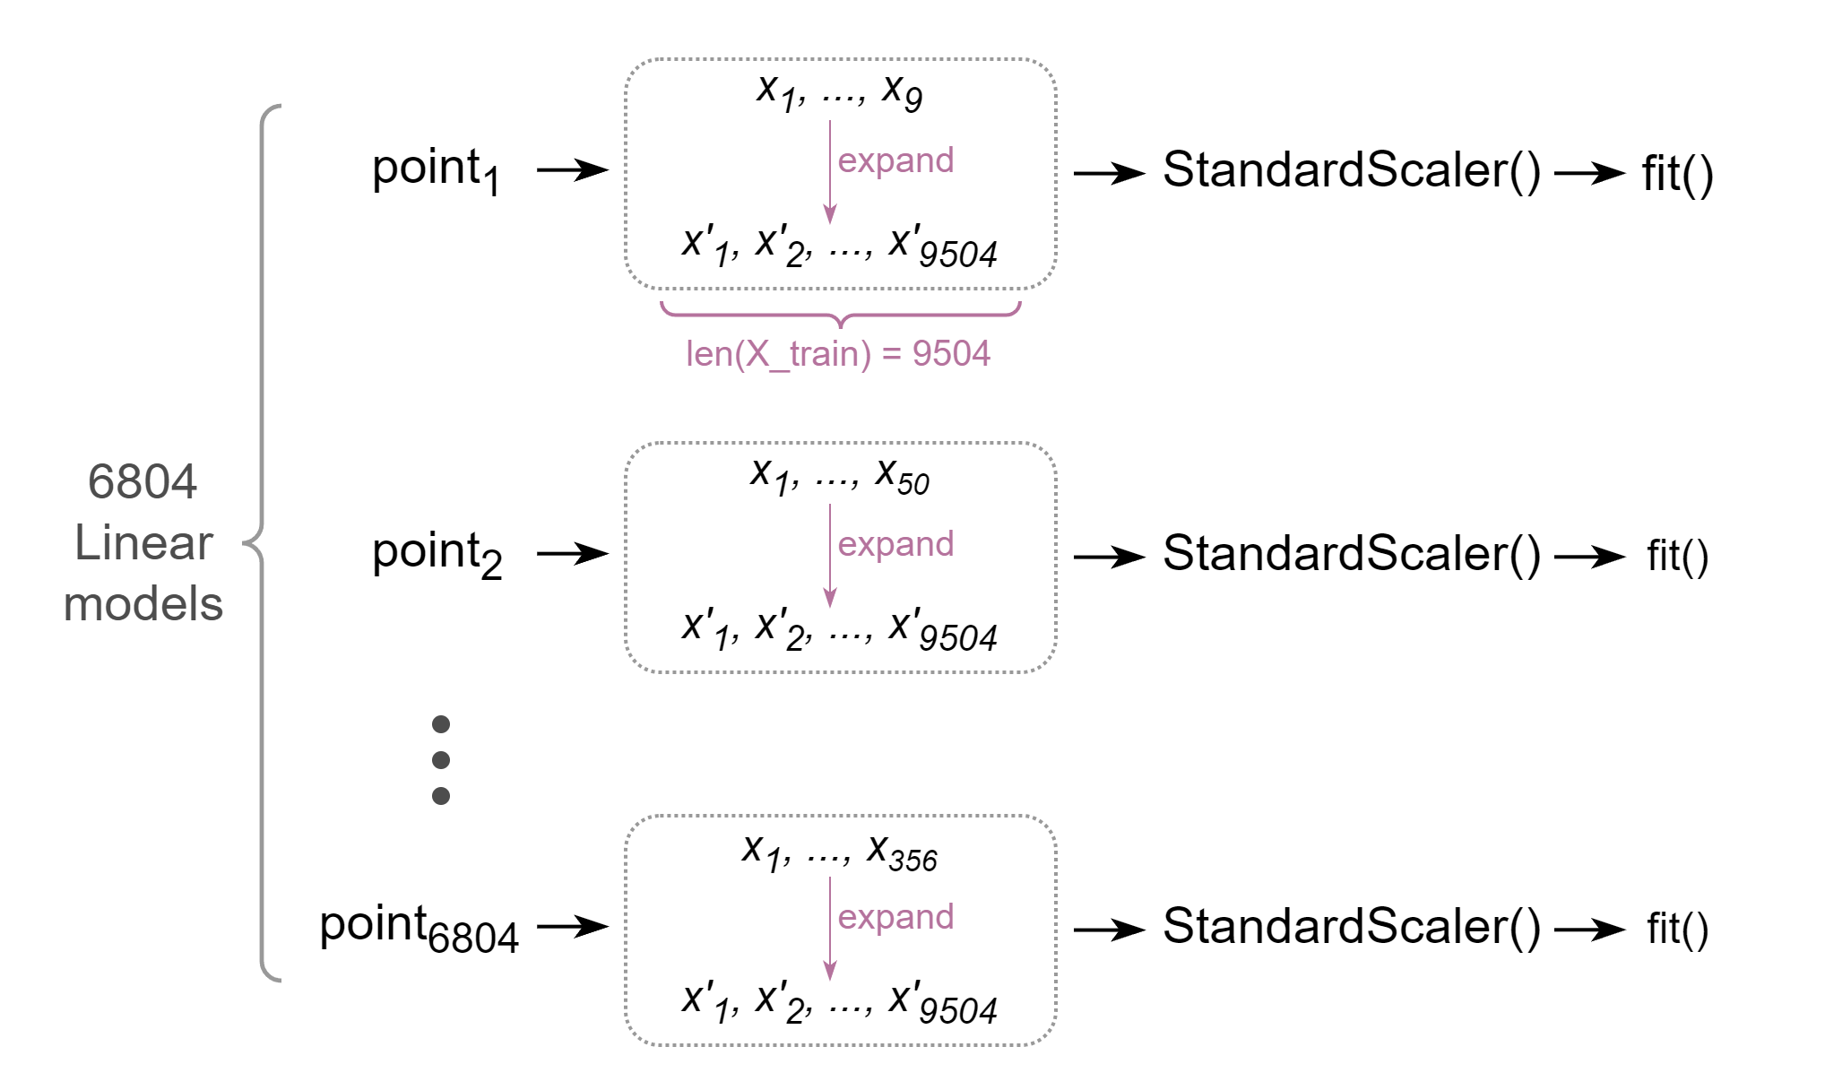
Linear regression: Pipeline overview

Slide 21
Linear regression: Results
Table 1: Linear regression validation metrics
 | Model predictions | True values | Model error | Baseline error
mean | 0.697 | 9.848 | 43.009 | 2.645
std | 1.035 | 6.471 | 122.642 | 3.869
min | 0.002 | 5 | 0.135 | 0.004
25% | 0.203 | 6 | 10.283 | 0.468
50% | 0.372 | 7 | 19.490 | 1.408
75% | 0.745 | 11 | 39.458 | 3.755
max | 10.509 | 40 | 2661.38 | 38.755

Slide 22
Linear regression: Results
Table 2: Linear regression test metrics
 | Model predictions | True values | Model error | Baseline error
mean | 0.880 | 9.683 | 70.863 | 2.621
std | 1.636 | 6.430 | 903.179 | 4.055
min | 0.0004 | 5 | 0.259 | 0.004
25% | 0.208 | 5 | 8.330 | 0.421
50% | 0.404 | 7 | 15.808 | 1.269
75% | 0.850 | 11 | 37.548 | 3.755
max | 27.791 | 40 | 23826.66 | 38.755

Slide 23
Model 2: LightGBM

Slide 24
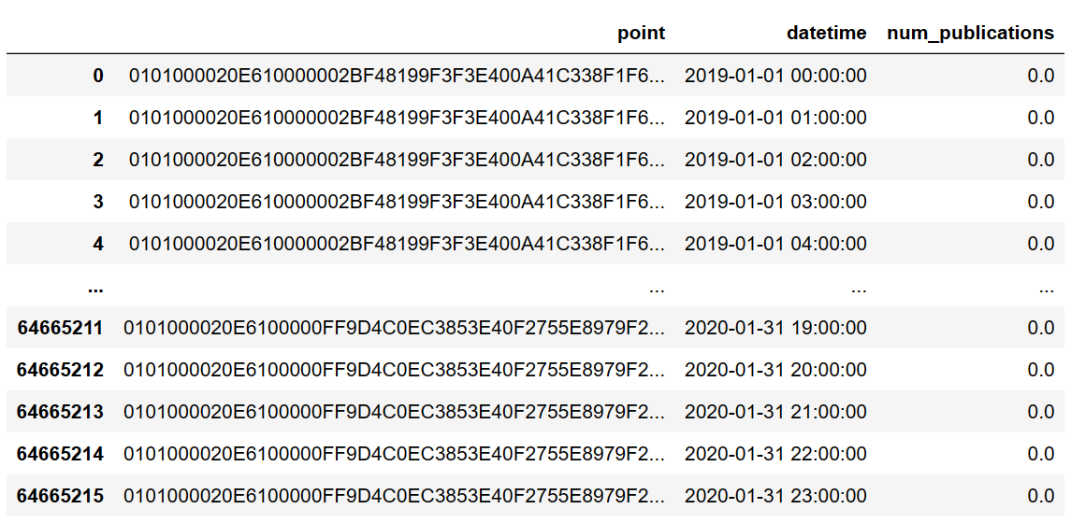
LightGBM: Data preparation
Input data for MLForecast object (with size 6804 x 9504)

Slide 25
LightGBM: Parameters and data transformation
For predictions MLForecast framework based on LightGBM model was used.
The key points in this model are:
Data frequency is an hour;
Time lags: from 1 day to 2 weeks with 24-hours increment;
Two transformations: rolling means for lags 24 and 48 with windows 7 * 24 and 7 * 24 (a week);
Datetime features: hour, day, day of week, week, month;
Attempted to use address as a feature.

Slide 26
LightGBM models: Comparison
Table 3: LightGBM validation metrics (address feature not used)
 | Model predictions | True values | Model error | Baseline error
mean | 8.087 | 9.848 | 1.094 | 2.645
std | 7.239 | 6.471 | 2.902 | 3.869
min | 0.283 | 5 | 0.0001 | 0.004
25% | 3.525 | 6 | 0.190 | 0.468
50% | 5.256 | 7 | 0.403 | 1.408
75% | 10.552 | 11 | 0.999 | 3.755
max | 46.442 | 40 | 56.533 | 38.755

Slide 27
LightGBM models: Comparison
Table 4: LightGBM validation metrics (address feature included)
 | Model predictions | True values | Model error | Baseline error
mean | 7.763 | 9.848 | 1.169 | 2.645
std | 7.292 | 6.471 | 2.841 | 3.869
min | 0.276 | 5 | 0.002 | 0.004
25% | 3.284 | 6 | 0.212 | 0.468
50% | 4.966 | 7 | 0.437 | 1.408
75% | 9.873 | 11 | 1.087 | 3.755
max | 47.686 | 40 | 51.551 | 38.755

Slide 28
LightGBM models: Results
Table 5: LightGBM test metrics
 | Model predictions | True values | Model error | Baseline error
mean | 8.155 | 9.683 | 0.843 | 2.621
std | 7.077 | 6.430 | 1.996 | 4.055
min | 0.576 | 5 | 0.0001 | 0.004
25% | 3.615 | 5 | 0.173 | 0.421
50% | 5.289 | 7 | 0.431 | 1.269
75% | 10.381 | 11 | 0.877 | 3.755
max | 47.055 | 40 | 40.880 | 38.755

Slide 29
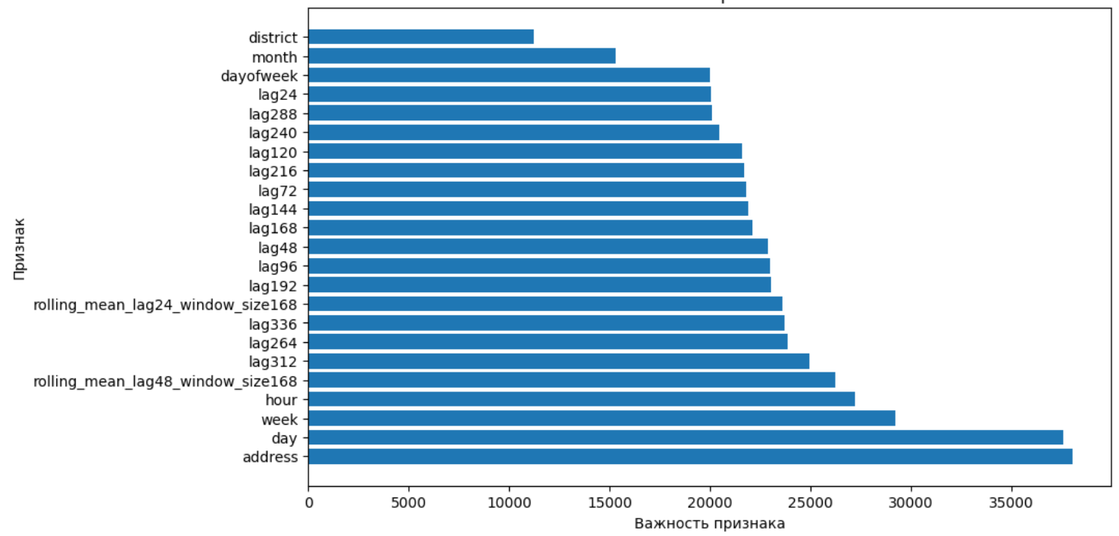
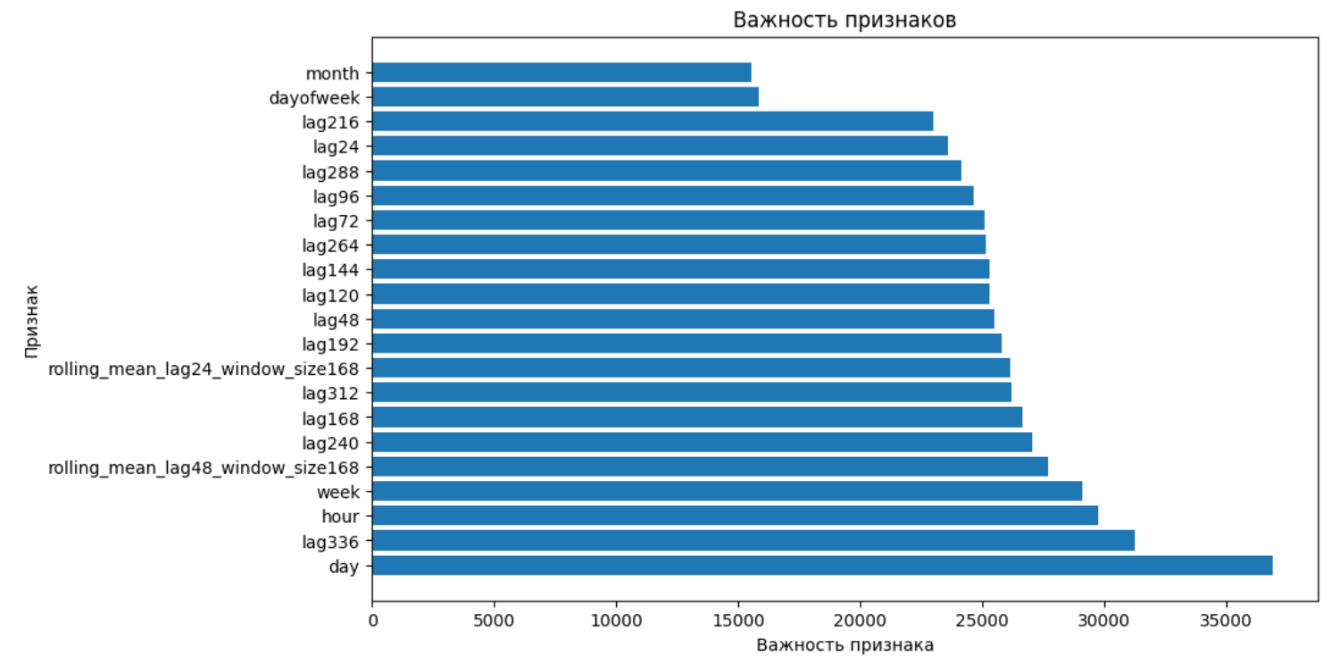
LightGBM models: Feature importance
Upper barplot: model with address feature;
Lower plot -
without address feature

Slide 30
Summary of results and conclusions
Exploratory analysis showed that number of publications for each polygon vastly differ;
Location with the most number of publications is the center of the city;
Polygons have their own trend, no uniform tendency;
Polygons have weekly seasonality, there is also weekday and hour-based dependences;
Linear regression model yielded low-quality results, probably because of data scarcity for most of the polygons;
LightGBM model with MLForecast framework was much more suitable for the task - the predictions are relatively high-quality;
For some reasons the usage of address feature raised the model error, although feature importance analysis showed that the “address” is as important as “day”.

Slide 31

THANK YOU FOR YOUR TIME!

